Slide 1
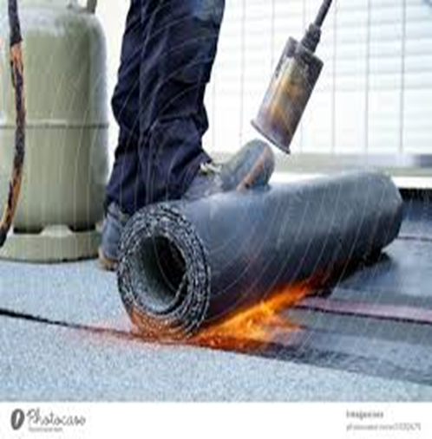
Waterproofing Maintenance

Slide 2
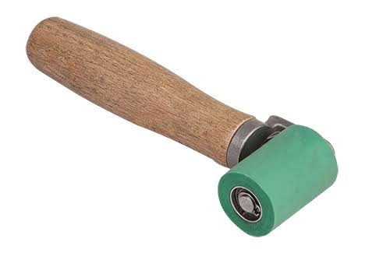
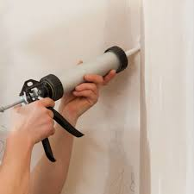
Basic Tools.
1. Rollers
- It is used when you need a thin film of the coating material .
2. PU Injection
-It is used to correct faults in concrete.

Slide 3
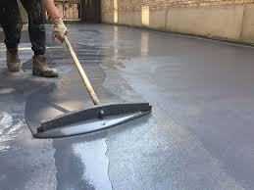
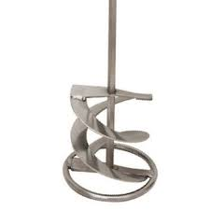
3. Epoxy Tools
- It is used for bonding concrete.
4. Stirrer
- It is used to mix fluid in a container .

Slide 4
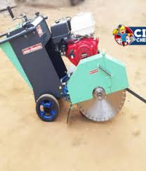
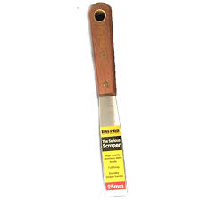
5.Groove Cutting Tool
- It is used to weaken the slab.
6. Steel Scrapper
- It is used for preparing the surface for finishing.

Slide 5
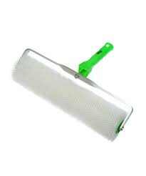
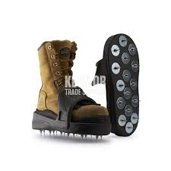
7. Spike Roller
- It is used for ensuring proper penetration.
8. Spike Shoes
- It is used to help to move on wet coatings.

Slide 6
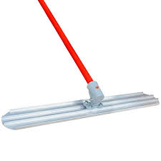
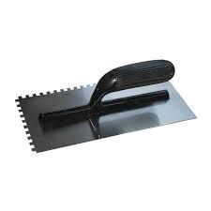
9. Magnesium Bull Float
- It is used to correct imperfections in the initial screeding process
10. Trowel
- It is used to ensure that the immediate surface to be coated remains sufficiently hydrated.

Slide 7
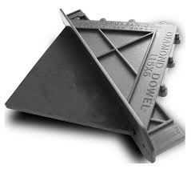
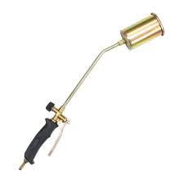
11. Dowel Plate
- It is used to provide load transfer between individual slabs .
12. Torch Gun
- It is used to heat asphalt material directly onto the roof.
Video :
https://youtu.be/kEVQDdgzgrQ?si=WcNnixX_kgUrcPRi
Feedback : Activity

Slide 8

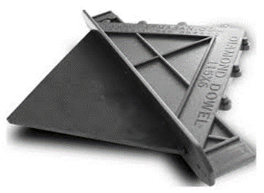


Kwa Thema Skills School
Subject : Maintenance Marks : 10
Grade : Year 1 Time : 30mins
Date : / / 2024
Question:1
1.Name the following hand tools that are used in waterproofing.
1.__________________ 2.____________________
3.___________________ 4. ____________________

Slide 9
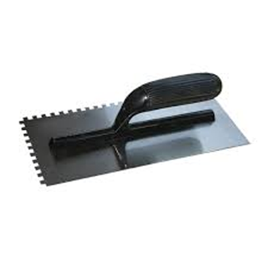


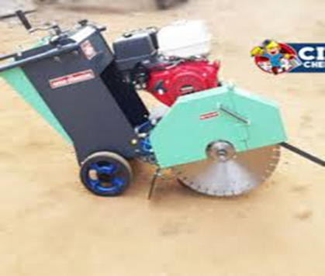


5. _________________ 6. ____________________
7. __________________ 8. ___________________
9. __________________ 10. ___________________
(10)
(Dowel plate; Spike roller; Trowel ; Groove cutting tool; Steel scrapper; Spike shoes; Stirrer; Epoxy tool; PU Injection; Torch gun)

Slide 10
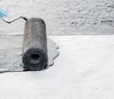
Feedback : Activity
(Practical lesson or Project)
Waterproofing

